Slide 1
Intro to Unity – Collisions

Slide 2
Collisions
Just like onMouseClick in Java…
There are many methods built into Unity
The one we care about now is:
void OnCollisionEnter2D(Collision2D coll)
{
// put whatever you want to happen if your
// object collides with another right here
}

Slide 3
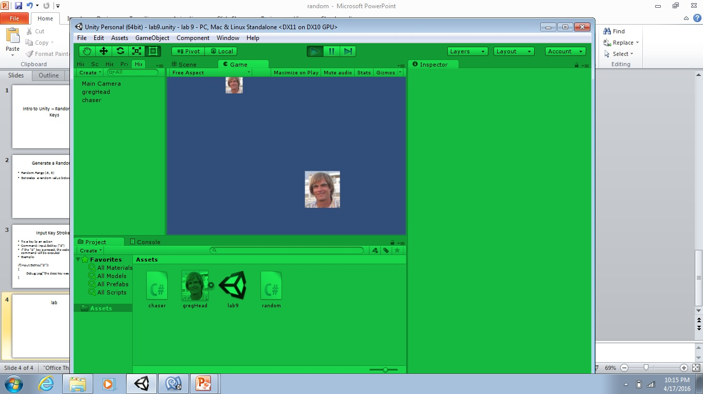
Lab – Hit the GameObject
control motion with
2 keys of your choice
continuously falls
by gravity

Slide 4
Lab Details
Falling GameObject is controlled by gravity
Left-right GameObject controlled by (keys)
User tries to move controlled GameObject so that it hits falling GameObject
When GameObjects collide, falling GameObject moves back to top of frame at a new Random x location.
Game is lost if the falling GameObject passes by the controlled GameObject

